Slide 1
Unit-5
Machine Learning (KOE073)

Slide 2
Genetic Algorithm
A genetic algorithm is an adaptive heuristic search algorithm. It is used to solve optimization problems in machine learning.
It is one of the important algorithms as it helps solve complex problems that would take a long time to solve.
Genetic Algorithms are being widely used in different real-world applications, for example, Designing electronic circuits, image processing, and artificial creativity etc.

Slide 3
Basic Terminologies Used
Population: Population is the subset of all possible or probable solutions, which can solve the given problem.
Chromosomes: A chromosome is one of the solutions in the population for the given problem, and the collection of gene generate a chromosome.
Gene: A chromosome is divided into a different gene, or it is an element of the chromosome.
Allele: Allele is the value provided to the gene within a particular chromosome.
Fitness Function: The fitness function is used to determine the individual's fitness level in the population. It means the ability of an individual to compete with other individuals. In every iteration, individuals are evaluated based on their fitness function.
Genetic Operators: In a genetic algorithm, the best individual mate to regenerate offspring better than parents. Here genetic operators play a role in changing the genetic composition of the next generation.
Selection: After calculating the fitness of every existent in the population, a selection process is used to determine which of the individualities in the population will get to reproduce and produce the seed that will form the coming generation.
A genetic algorithm uses genetic and natural selection concepts to solve optimization problems.

Slide 4
How Genetic Algorithm Work?
The genetic algorithm works on the evolutionary generational cycle to generate high-quality solutions. These algorithms use different operations that either enhance or replace the population to give an improved fit solution.
It basically involves five phases to solve the complex optimization problems, which are given as below:
Initialization
Fitness Assignment
Selection
Reproduction
Termination

Slide 5
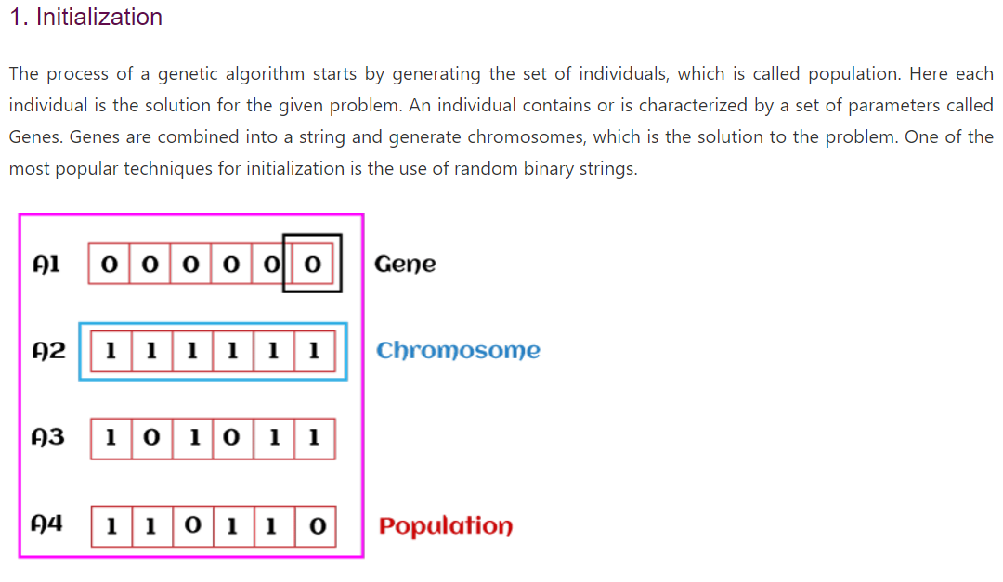

Slide 6
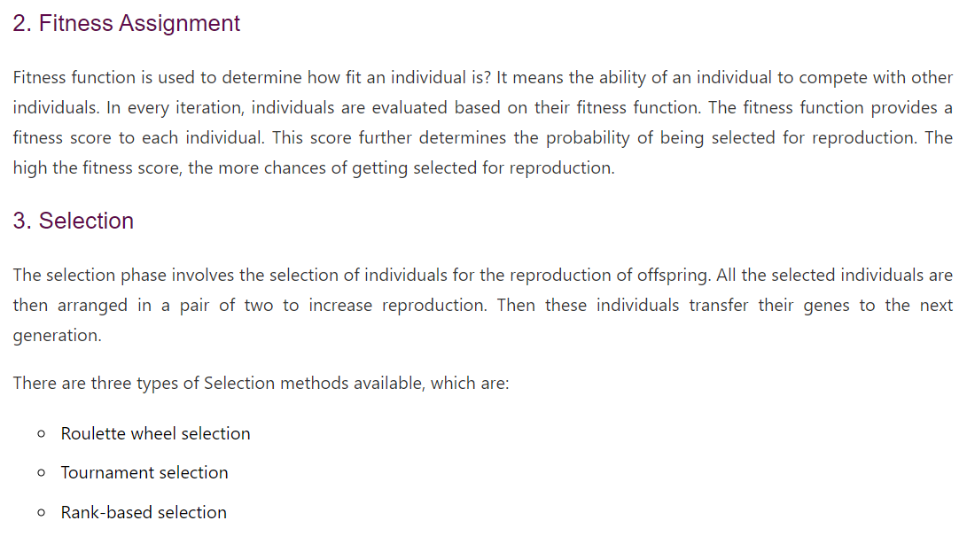

Slide 7
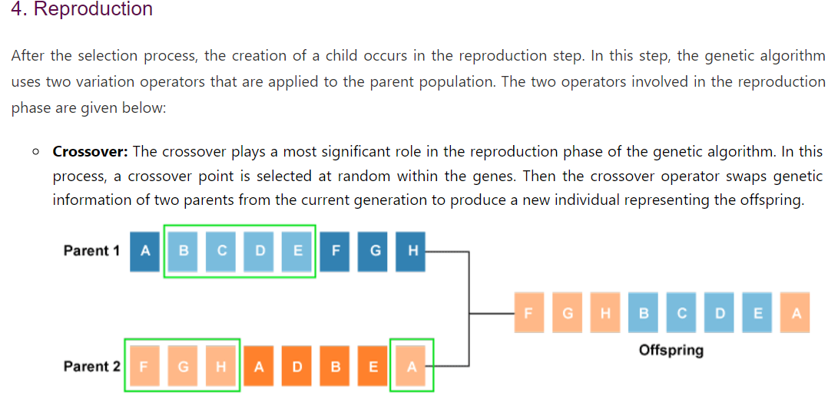

Slide 8
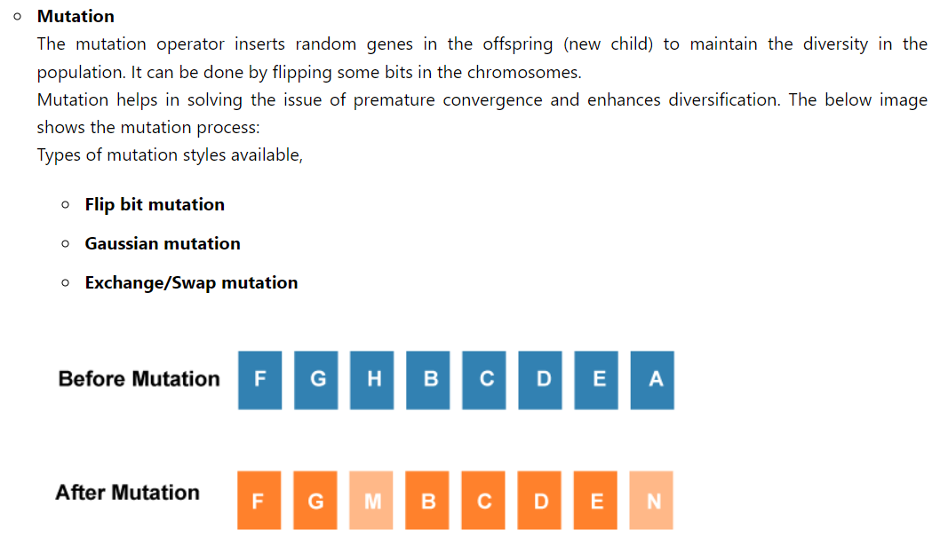
5. Termination
After the reproduction phase, a stopping criterion is applied as a base for termination. The algorithm terminates after the threshold fitness solution is reached. It will identify the final solution as the best solution in the population.

Slide 9
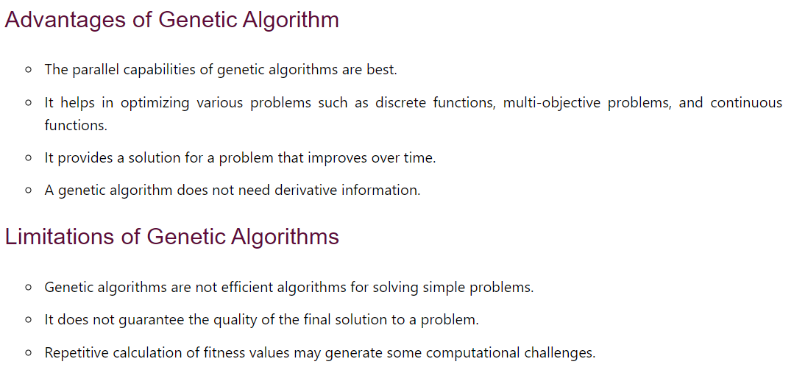

Slide 10
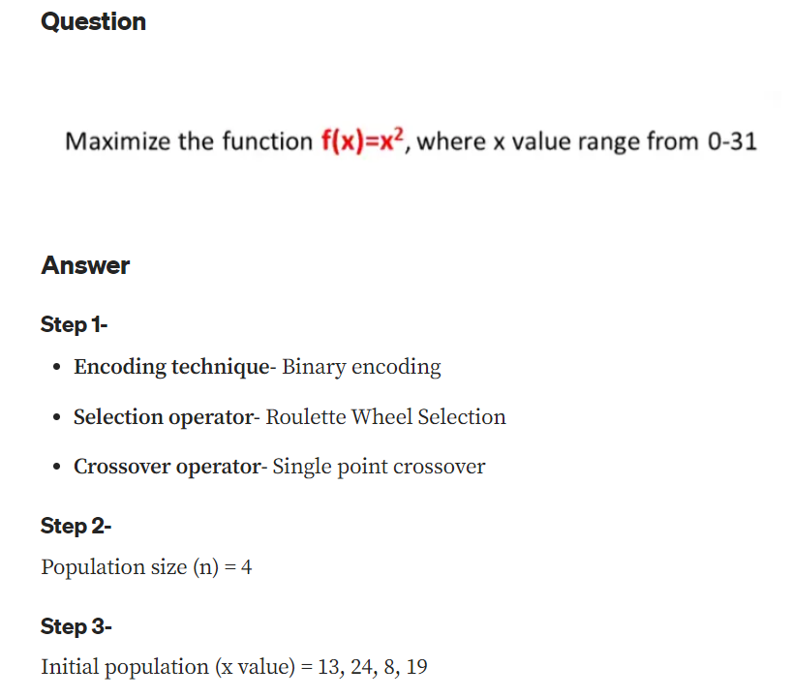

Slide 11
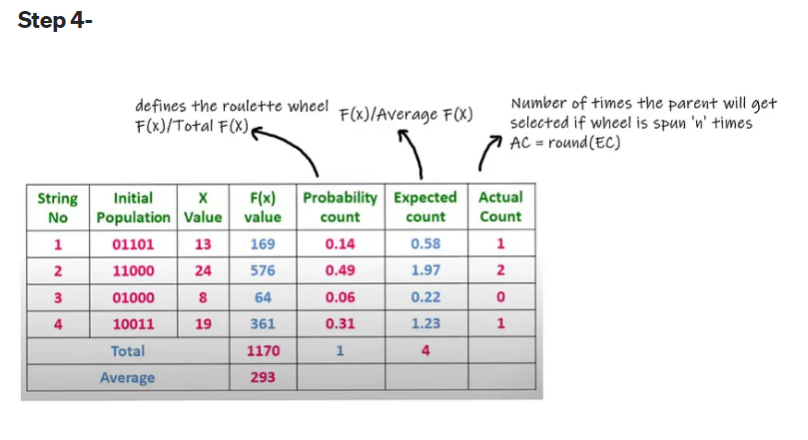

Slide 12
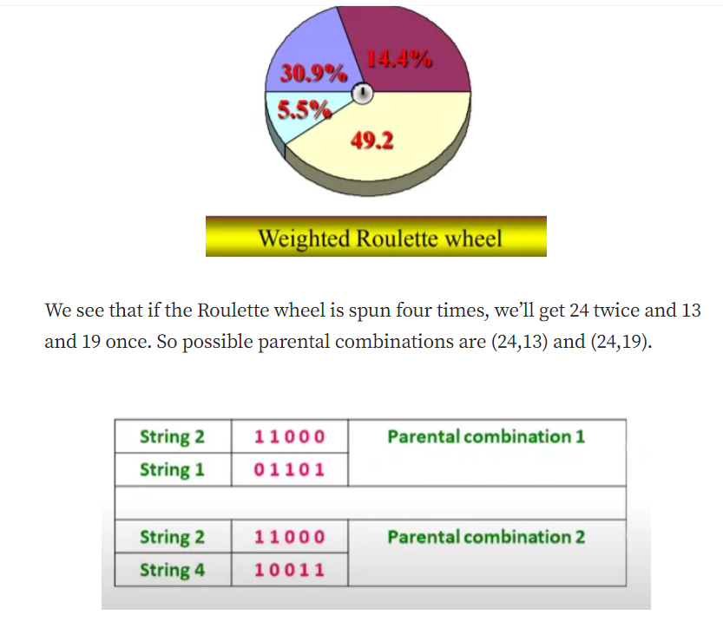

Slide 13
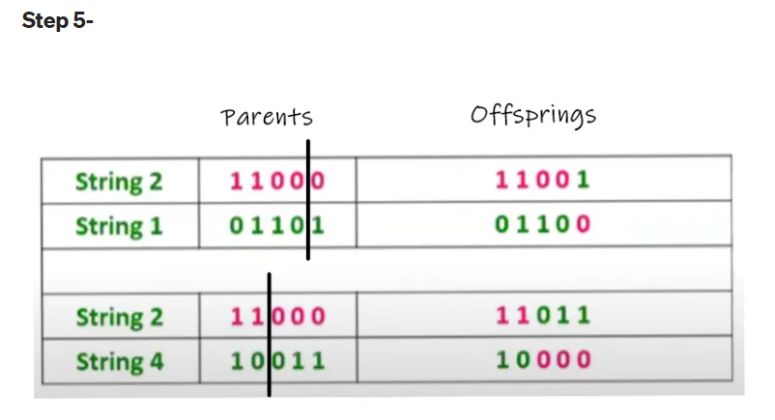

Slide 14
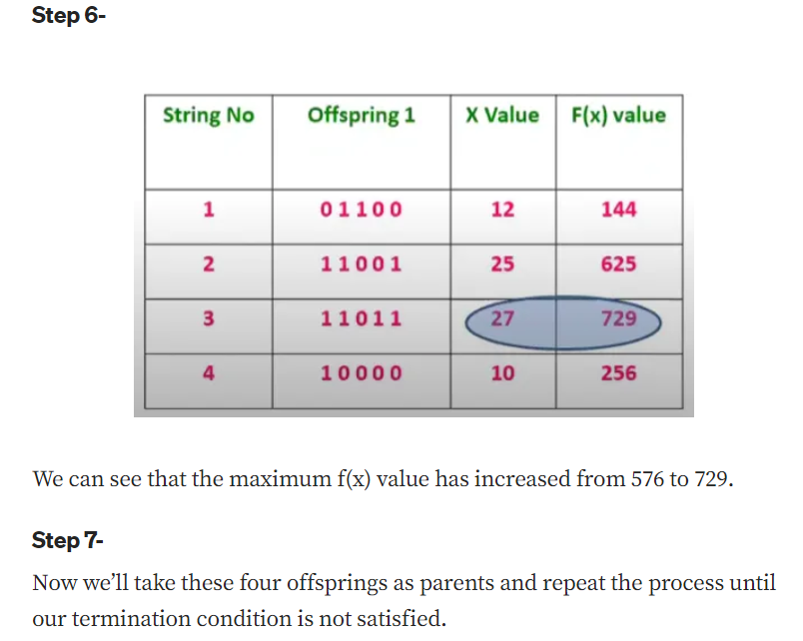

Slide 15
Genetic algorithm: Hypothesis space search
Genetic algorithms employ a randomized search method to seek maximally fit hypotheses.
It replaces the parent hypotheses with an offspring that can be very different from the parent. Due to this reason, genetic algorithm search has lower chances of it falling into the same kind of local minima.
There is one practical difficulty that is often encountered in genetic algorithms, it is crowding.

Slide 16
Crowding can be defined as the phenomenon in which some individuals that are more fit in comparison to others, reproduce quickly, therefore the copies of this individual take over a larger fraction of the population.
The negative impact of crowding is that it reduces the diversity of the population, thereby slowing further progress by the GA.

Slide 17
Genetic Programming
Genetic programming (GP) is a form of evolutionary computation in which the individuals in the evolving population are computer programs rather than bit strings.
Koza (1992) describes the basic genetic programming approach and presents a broad range of simple programs that can be successfully learned by GP.
Programs manipulated by a GP are typically represented by trees corresponding to the parse tree of the program. Each function call is represented by a node in the tree, and the arguments to the function are given by its descendant nodes.

Slide 18

For Example: Tree representation for the function
To apply genetic programming to a particular domain, the user must define the primitive functions to be considered.
As in a genetic algorithm, the prototypical genetic programming algorithm maintains a population of individuals (in this case, program trees).
On each iteration, it produces a new generation of individuals using selection, crossover, and mutation.
The fitness of a given individual program in the population is typically determined by executing the program on a set of training data.
Crossover operations are performed by replacing a randomly chosen subtree of one parent program by a subtree from the other parent program.

Slide 19
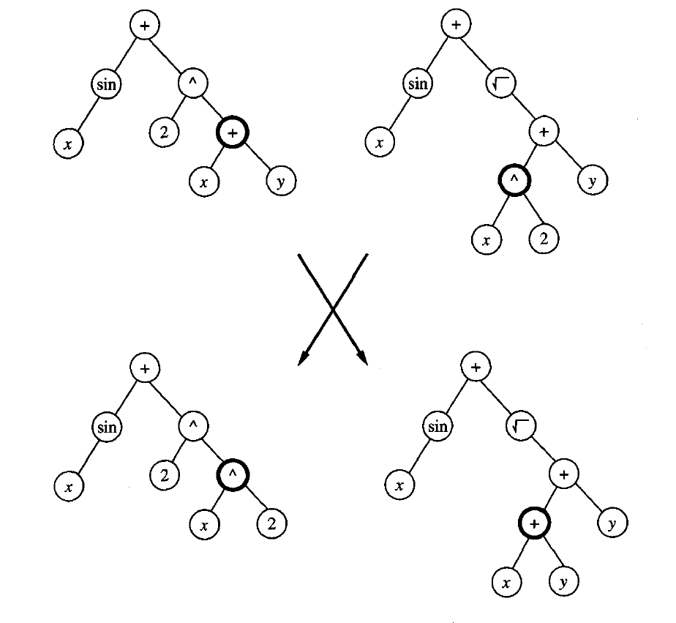

Slide 20
Models of Evolution And Learning
In many natural systems, individual organisms learn to adapt significantly during their lifetime. At the same time, biological and social processes allow their species to adapt over a time frame of many generations. One interesting question regarding evolutionary systems is "What is the relationship between learning during the lifetime of a single individual, and the longer time frame species-level learning afforded by evolution?’
Lamarckian Evolution
Baldwin Effect

Slide 21
Lamarckian Evolution
Lamarck was a scientist who, in the late nineteenth century, proposed that evolution over many generations was directly influenced by the experiences of individual organisms during their lifetime.
In particular, he proposed that experiences of a single organism directly affected the genetic makeup of their offspring.
If an individual learned during its lifetime to avoid some toxic food, it could pass this trait on genetically to its offspring, which therefore would not need to learn the trait.

Slide 22
Baldwin Effect
It explains about the learning behavior.
Baldwin proposed that individual learning can explain evolutionary phenomena that appear to require Lamarckian inheritance of acquired characteristics.
The ability of individuals to learn can guide the evolutionary process.
He focused on two things:
Genotype: genetic code (DNA)
Phenotype: characteristics (behavior)

Slide 23
Parallelizing Genetic Algorithms
GAS are naturally suited to parallel implementation, and a number of approaches to parallelization have been explored.
Coarse grain approaches to parallelization subdivide the population into somewhat distinct groups of individuals, called demes. (divided into fewer components)
Each deme is assigned to a different computational node, and a standard GA search is performed at each node. Communication and cross-fertilization between demes occurs on a less frequent basis than within demes.
Transfer between demes occurs by a migration process, in which individuals from one deme are copied or transferred to other demes.
One benefit of such approaches is that it reduces the crowding problem often encountered in nonparallel GAS, in which the system falls into a local optimum due to the early appearance of a genotype that comes to dominate the entire population.

Slide 24
Fine grain approaches
In contrast to coarse-grained parallel implementations of GAS, fine-grained implementations typically assign one processor per individual in the population.
Detailed description which deals with much smaller components.

Slide 25
Learning Sets of Rules
It is useful to learn the target function represented as a set of if-then rules that jointly define the function.
Many algorithms are there that directly learn rule sets defining two parameters:
They are designed to learn first order rules that contain variables.
The algorithm uses sequential covering algorithms that learn one rule at a time to incrementally grow the final set of rules.

Slide 26
Sequential Covering Algorithm
Sequential Covering is a popular algorithm based on Rule-Based Classification used for learning a disjunctive set of rules.
The basic idea here is to learn one rule, remove the data that it covers, then repeat the same process.
In this way, it covers all the rules involved with it in a sequential manner during the training phase.

Slide 27
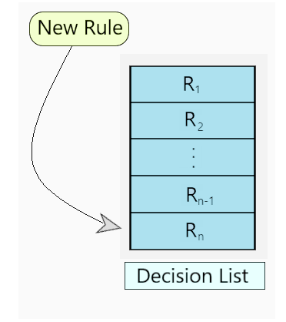
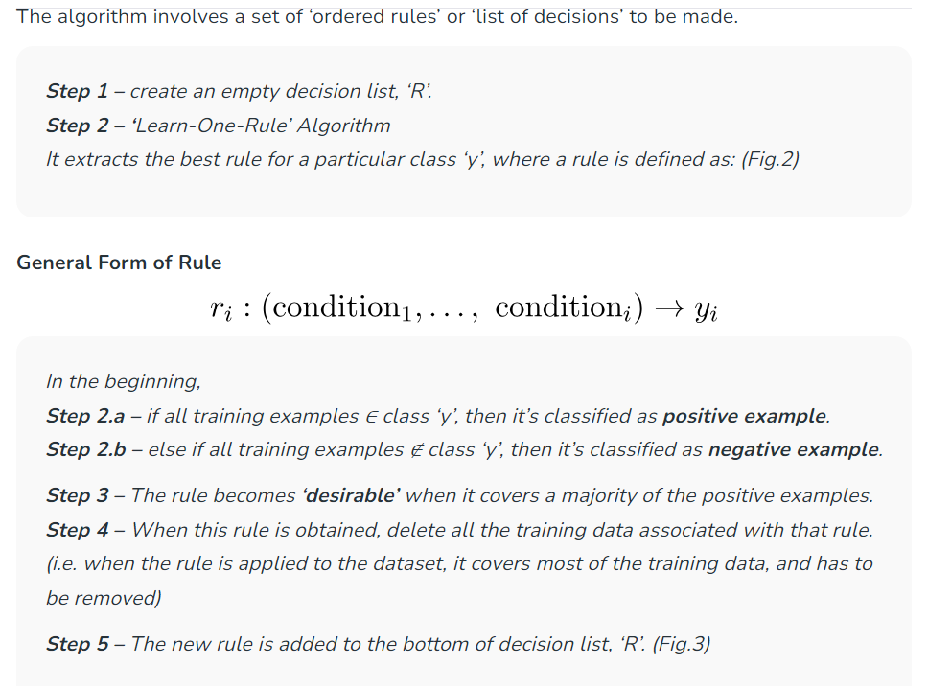
Working on the Algorithm:

Slide 28
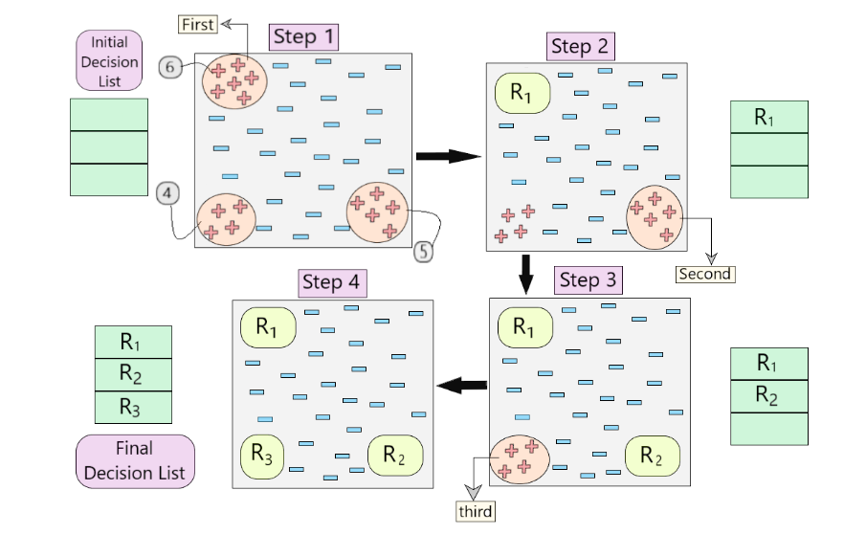

Slide 29
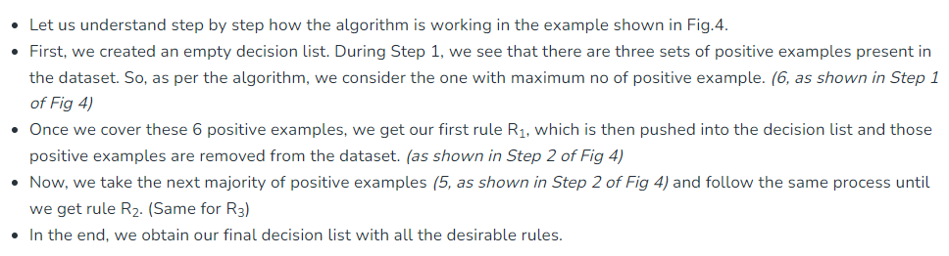
Sequential Learning is a powerful algorithm for generating rule-based classifiers in Machine Learning. It uses ‘Learn-One-Rule’ algorithm as its base to learn a sequence of disjunctive rules.

Slide 30
General to Specific Beam Search
One effective approach to implement LEARN-ONE-RULE is to organize the hypothesis space search in the same general fashion as the ID3 algorithm, but to follow only the most promising branch in the tree at each step.
The search begins by considering the most general rule precondition possible (the empty test that matches every instance), then greedily adding the attribute test that most improves rule performance measured over the training examples.
Once this test has been added, the process is repeated by greedily adding a second attribute test and so on.
This way this process grows the hypothesis by greedily adding new attributes tests until the hypothesis reaches an acceptable level of performance.

Slide 31
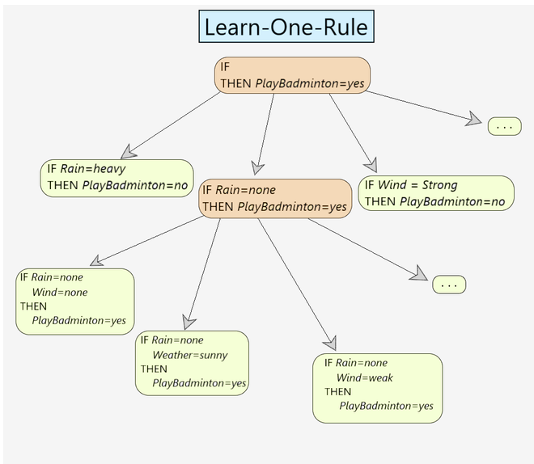

Slide 32
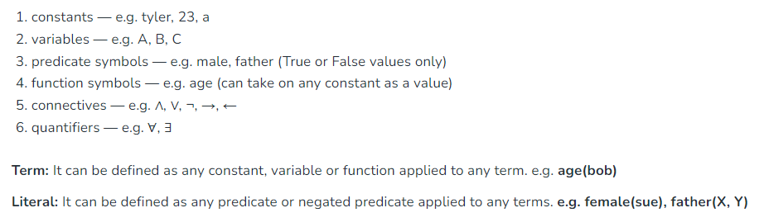
First-Order Logic
All expressions in first-order logic are composed of the following attributes:

Slide 33
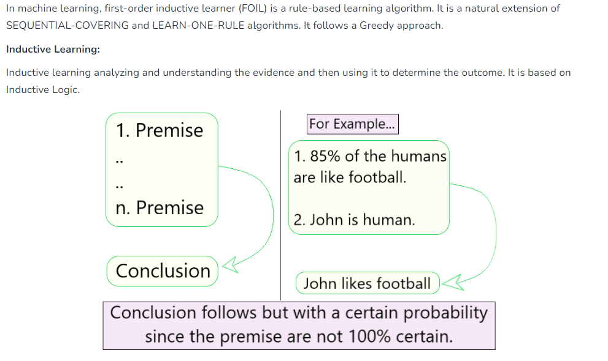
First Order Inductive Learner (FOIL)

Slide 34
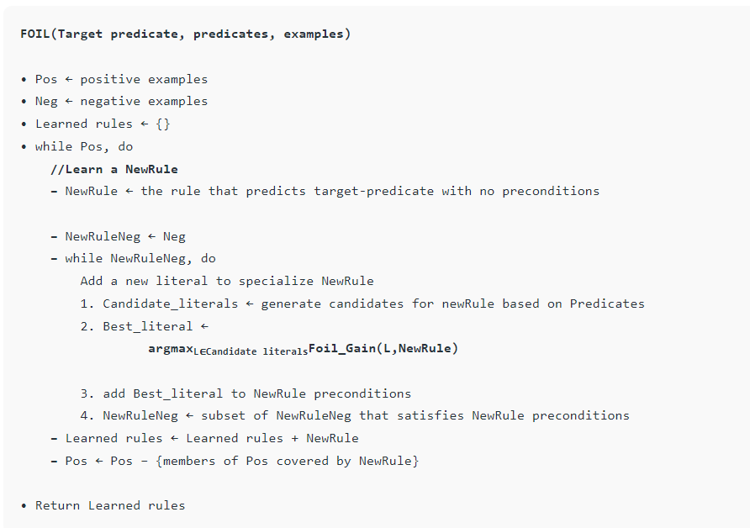

Slide 35
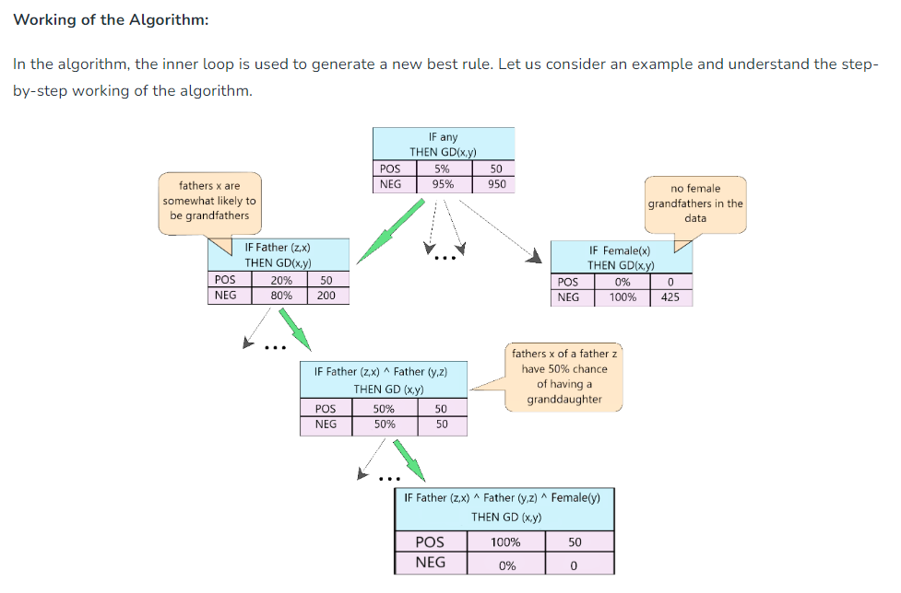

Slide 36
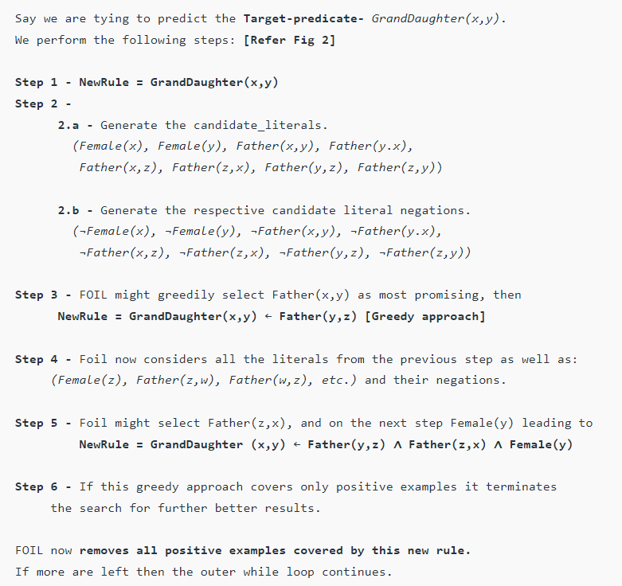

Slide 37
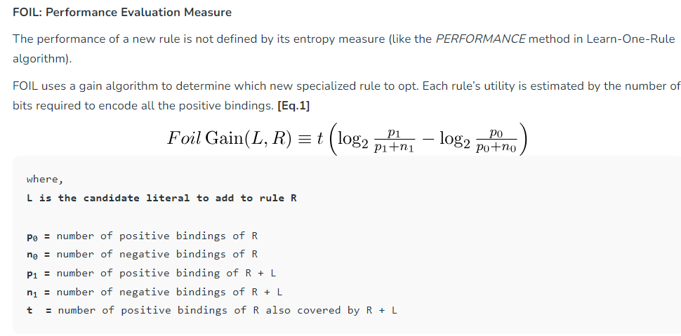
FOIL Algorithm is another rule-based learning algorithm that extends on the Sequential Covering + Learn-One-Rule algorithms and uses a different Performance metrics (other than entropy/information gain) to determine the best rule possible.

Slide 38
Reinforcement learning
Reinforcement learning differs from supervised learning in a way that in supervised learning the training data has the answer key with it so the model is trained with the correct answer itself whereas in reinforcement learning, there is no answer but the reinforcement agent decides what to do to perform the given task.
In the absence of a training dataset, it is bound to learn from its experience.
Reinforcement Learning (RL) is the science of decision making. It is about learning the optimal behavior in an environment to obtain maximum reward.

Slide 39
In RL, the data is accumulated from machine learning systems that use a trial-and-error method. Data is not part of the input that we would find in supervised or unsupervised machine learning.
Reinforcement learning uses algorithms that learn from outcomes and decide which action to take next. After each action, the algorithm receives feedback that helps it determine whether the choice it made was correct, neutral or incorrect.
It is a good technique to use for automated systems that have to make a lot of small decisions without human guidance.
Reinforcement learning is an autonomous, self-teaching system that essentially learns by trial and error. It performs actions with the aim of maximizing rewards, or in other words, it is learning by doing in order to achieve the best outcomes.

Slide 40
Main Points
Input: The input should be an initial state from which the model will start
Output: There are many possible outputs as there are a variety of solutions to a particular problem
Training: The training is based upon the input, The model will return a state and the user will decide to reward or punish the model based on its output.
The model keeps continues to learn.
The best solution is decided based on the maximum reward.

Slide 41
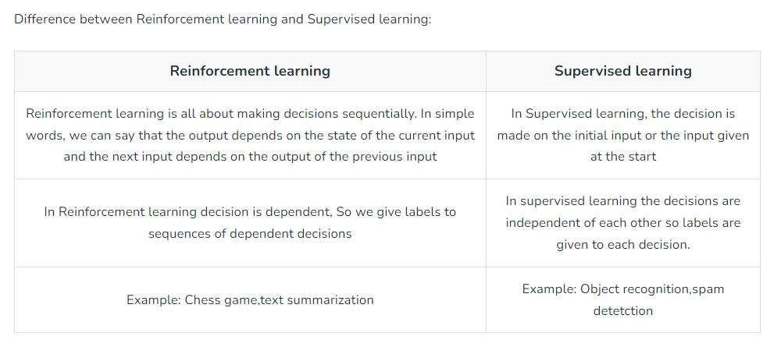

Slide 42
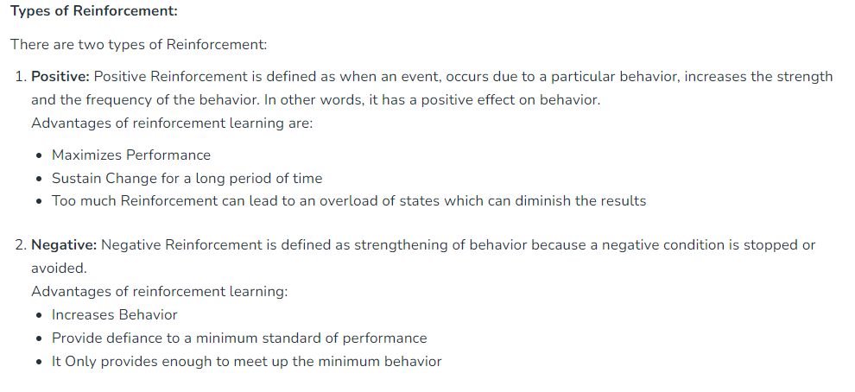

Slide 43
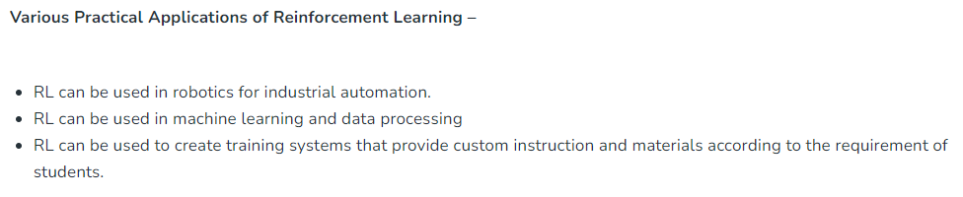
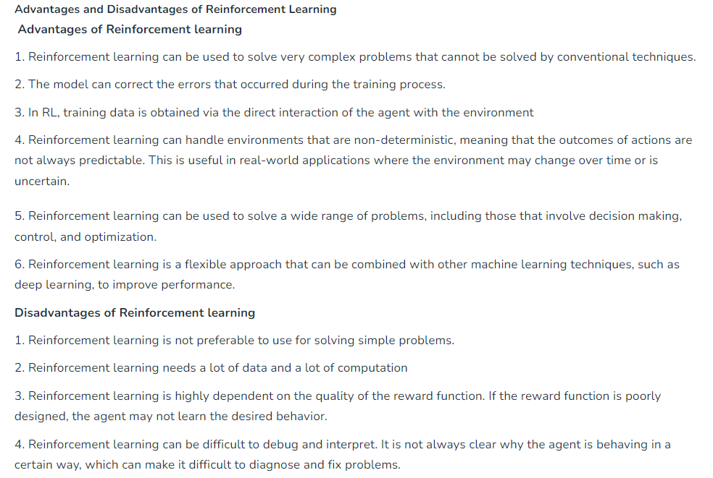

Slide 44
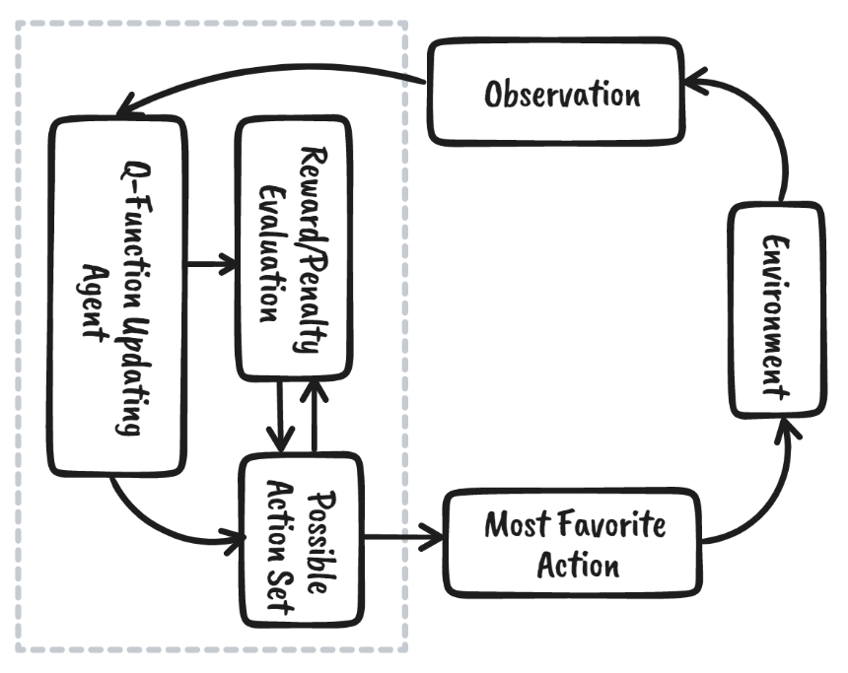
Q-Learning Reinforcement learning
Its a basic form of Reinforcement Learning which uses Q-values (also called action values) to iteratively improve the behavior of the learning agent.

Slide 45
We can break down reinforcement learning into five simple steps:
The agent is at state zero in an environment.
It will take an action based on a specific strategy.
It will receive a reward or punishment based on that action.
By learning from previous moves and optimizing the strategy.
The process will repeat until an optimal strategy is found.

Slide 46
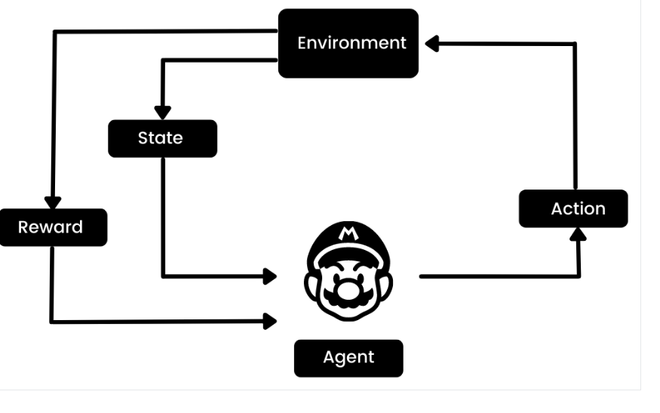
For example, in the Mario video game, if a character takes a random action (e.g. moving left), based on that action, it may receive a reward. After taking the action, the agent (Mario) is in a new state, and the process repeats until the game character reaches the end of the stage or dies.
This episode will repeat multiple times until Mario learns to navigate the environment by maximizing the rewards.

Slide 47
What is Q-Learning?
Q-learning is a model-free, value-based, off-policy algorithm that will find the best series of actions based on the agent's current state. The “Q” stands for quality. Quality represents how valuable the action is in maximizing future rewards.
The model-based algorithms use transition and reward functions to estimate the optimal policy and create the model. In contrast, model-free algorithms learn the consequences of their actions through the experience without transition and reward function.
The value-based method trains the value function to learn which state is more valuable and take action. On the other hand, policy-based methods train the policy directly to learn which action to take in a given state.
In the off-policy, the algorithm evaluates and updates a policy that differs from the policy used to take an action. Conversely, the on-policy algorithm evaluates and improves the same policy used to take an action.

Slide 48
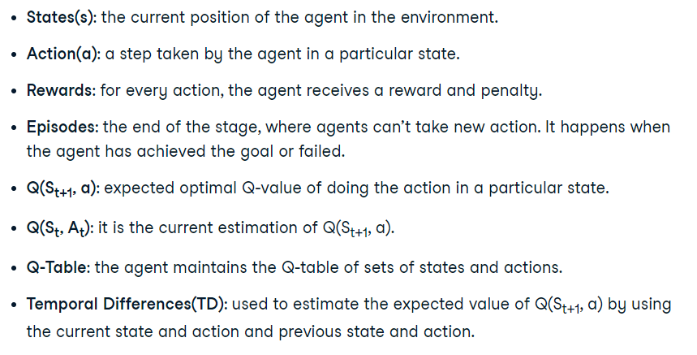
Key Terminologies in Q-learning

Slide 49
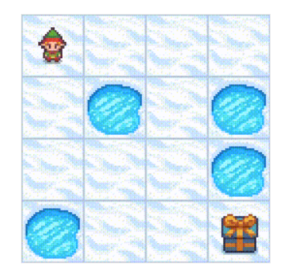
How Does Q-Learning Work?
Lets take an example of a frozen lake. In this environment, the agent must cross the frozen lake from the start to the goal, without falling into the holes. The best strategy is to reach goals by taking the shortest path.

Slide 50
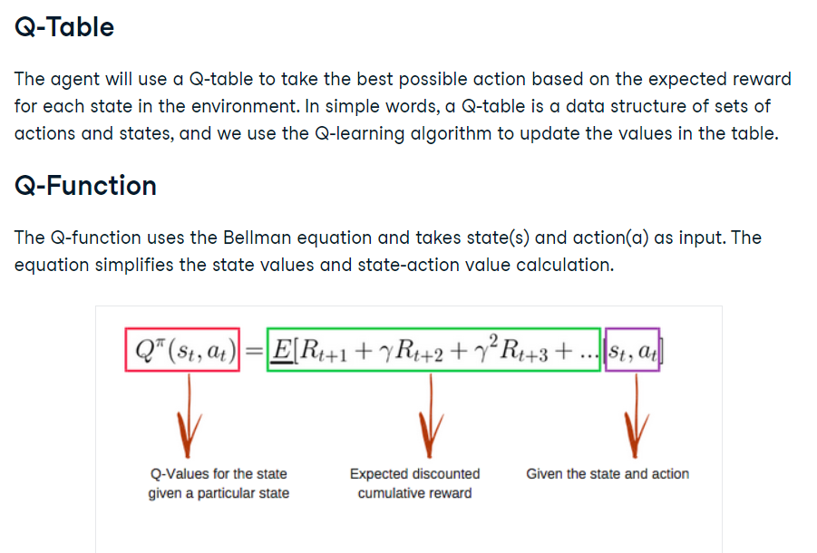

Slide 51
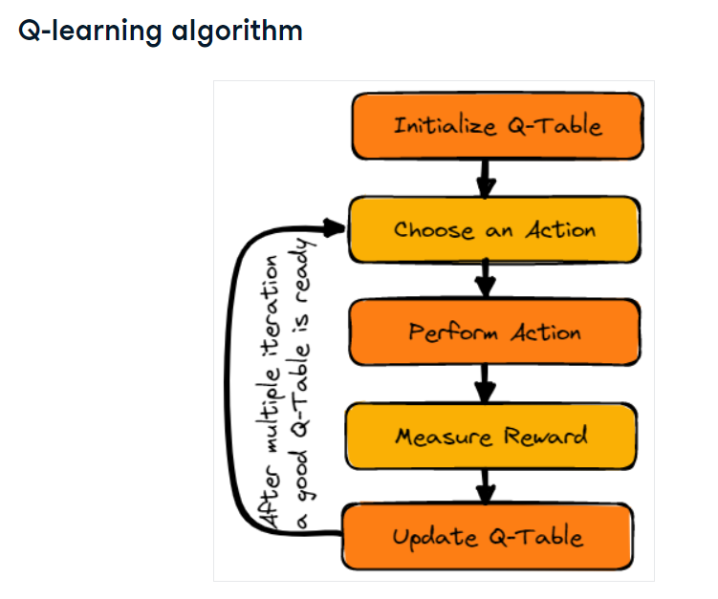

Slide 52
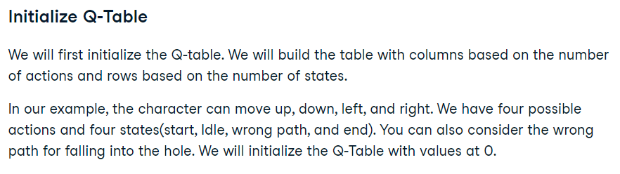
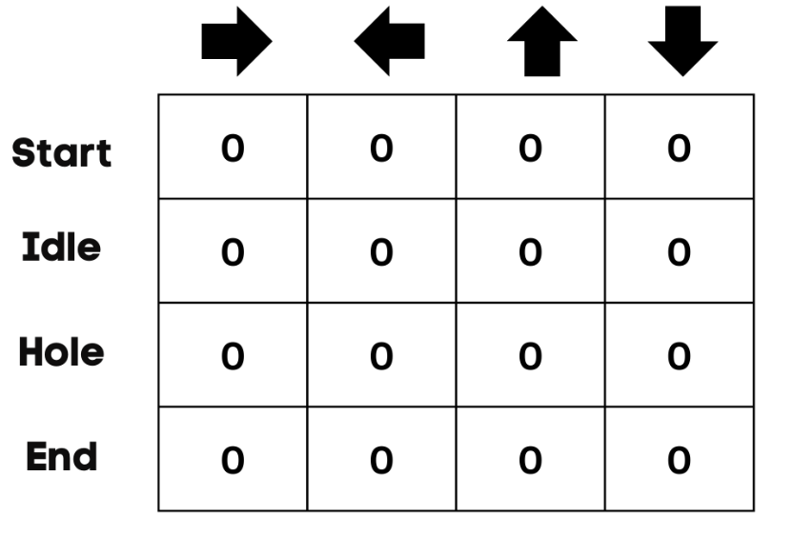

Slide 53
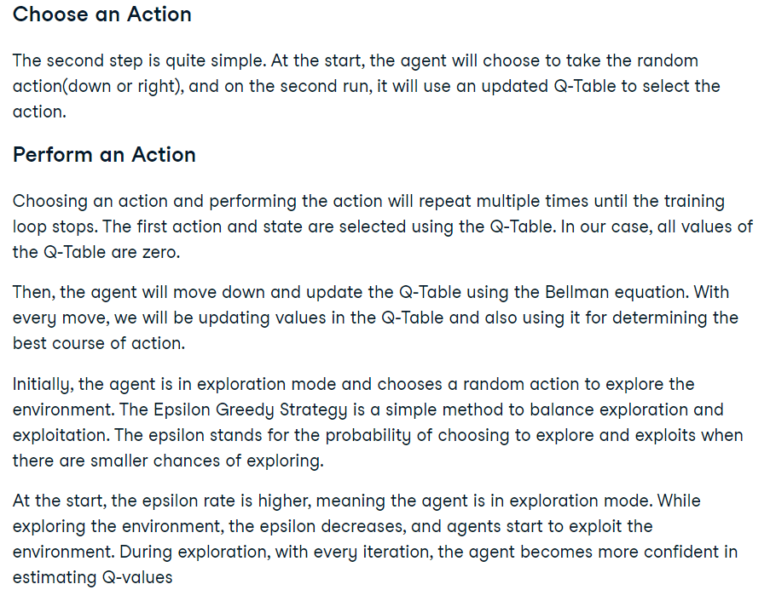

Slide 54
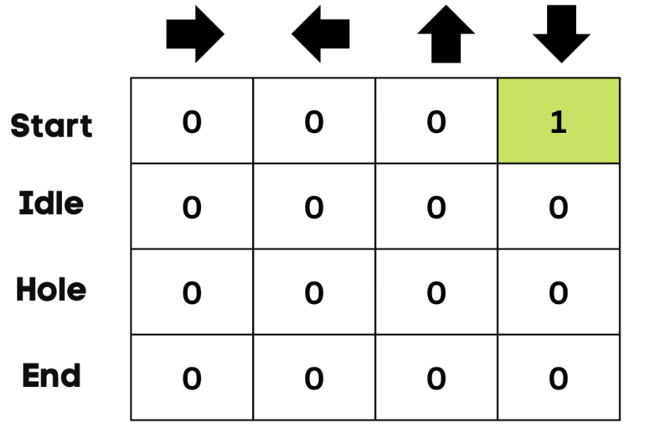
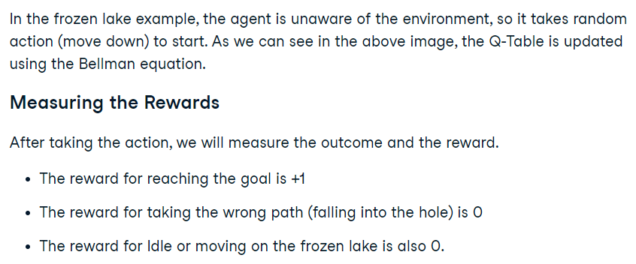

Slide 55
